Slide 1
Traffic-Sign-Recognition
using a Concept Bottleneck Model
Luka Vracevic, Fabian Aurin, Aaron Ziglowski
16.12.2025

Slide 2
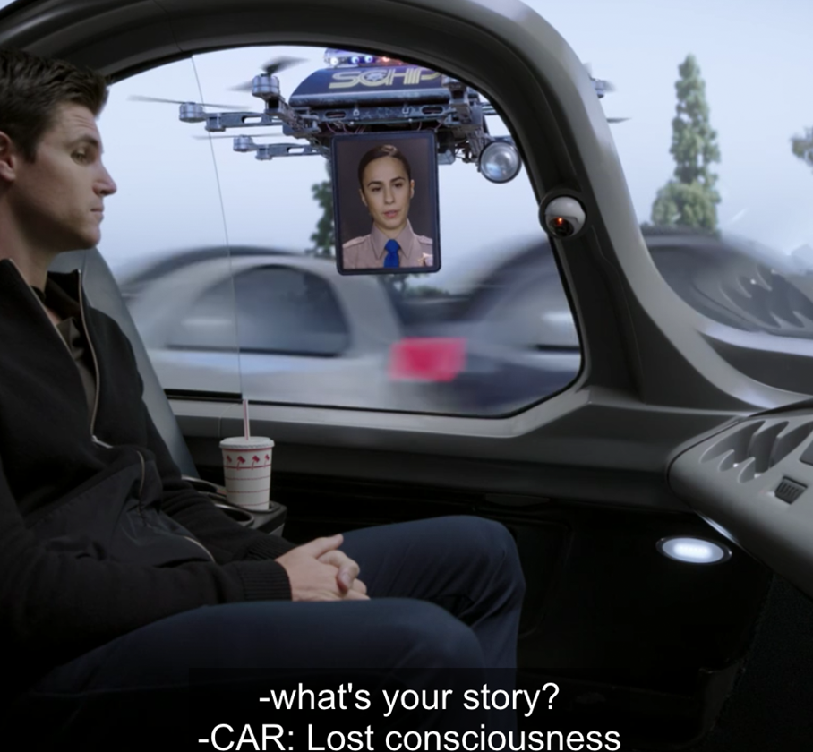

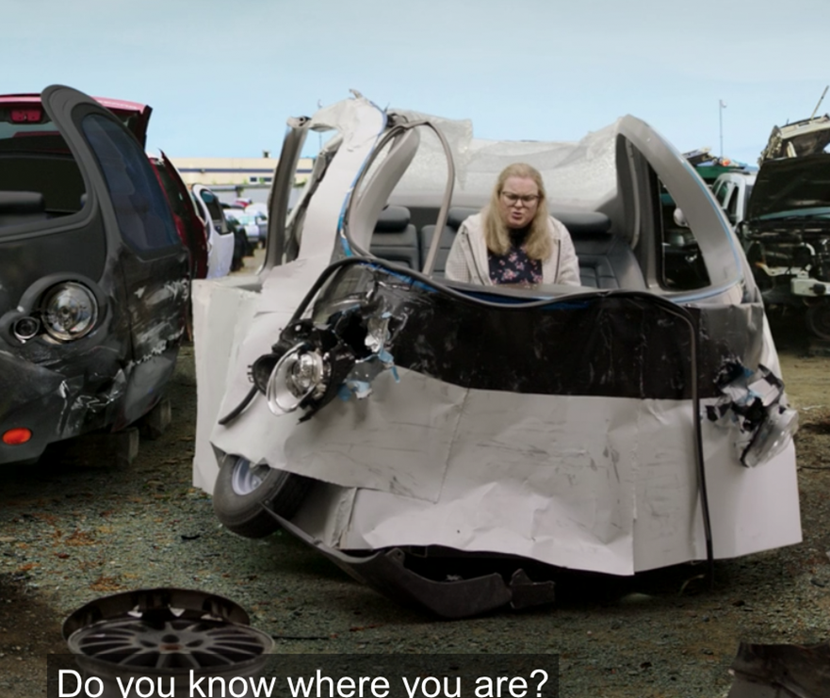
Problem Statement
Intermediate Presentation
?!
Self-driving Car
Road Sign
Not-driving car
Somewhere in the near future
As per usual
The bad ending

Slide 3
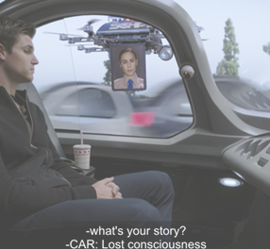
Problem Statement
Intermediate Presentation
CBM
Self-driving Car
Road Sign
Still-driving car
Somewhere in the near future
As per usual
The good ending

Slide 4
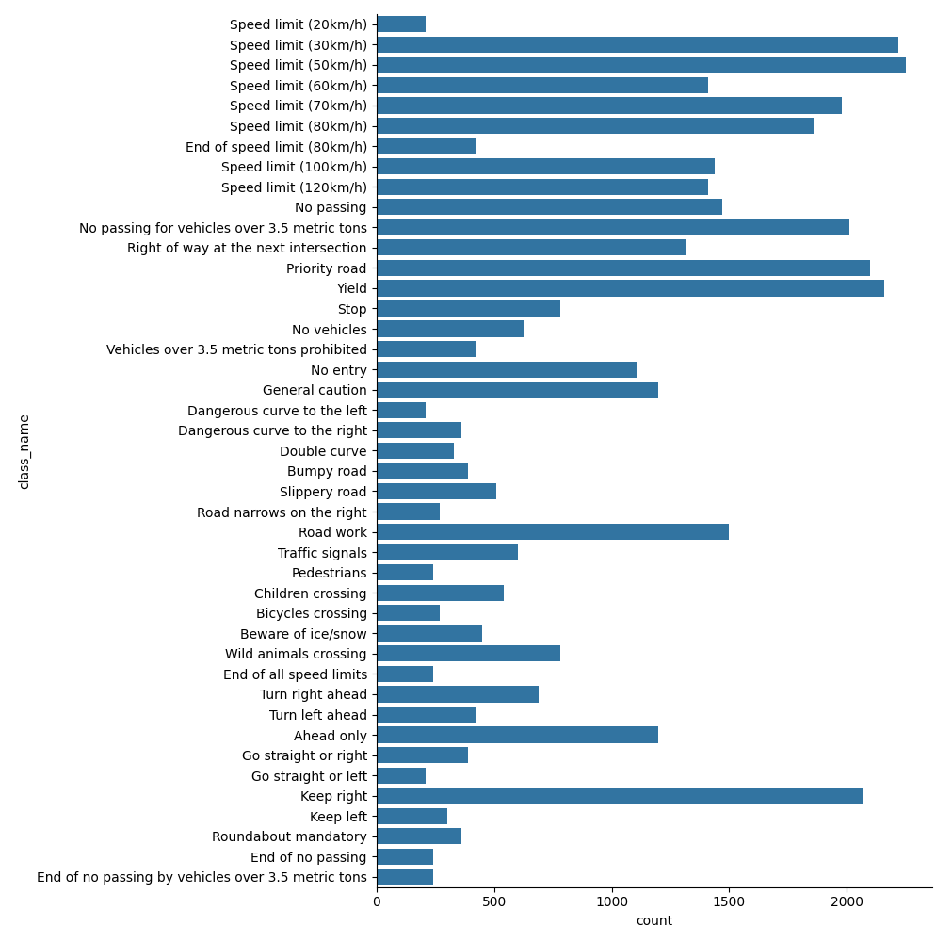
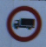


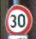

EDA Results
Class distribution & Samples
Note that:
Class frequency varies greatly → stratify
Intuitively similar signs are present in very different quantities (e.g. Keep right vs Keep left)
Image size & lighting differs
16.12.2025

Slide 5
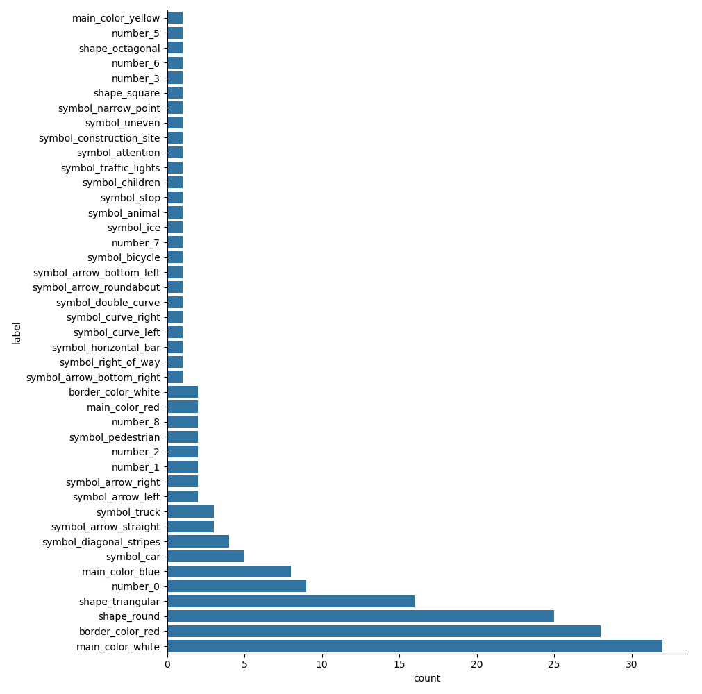
EDA Results
Concept distribution
Note that:
Only a small subset of concepts is present in more than 5 signs
26 concepts are present exactly once
80% of all concepts are present at most twice
This may cause high concepts → signs accuracy for classes possessing unique features
16.12.2025

Slide 6
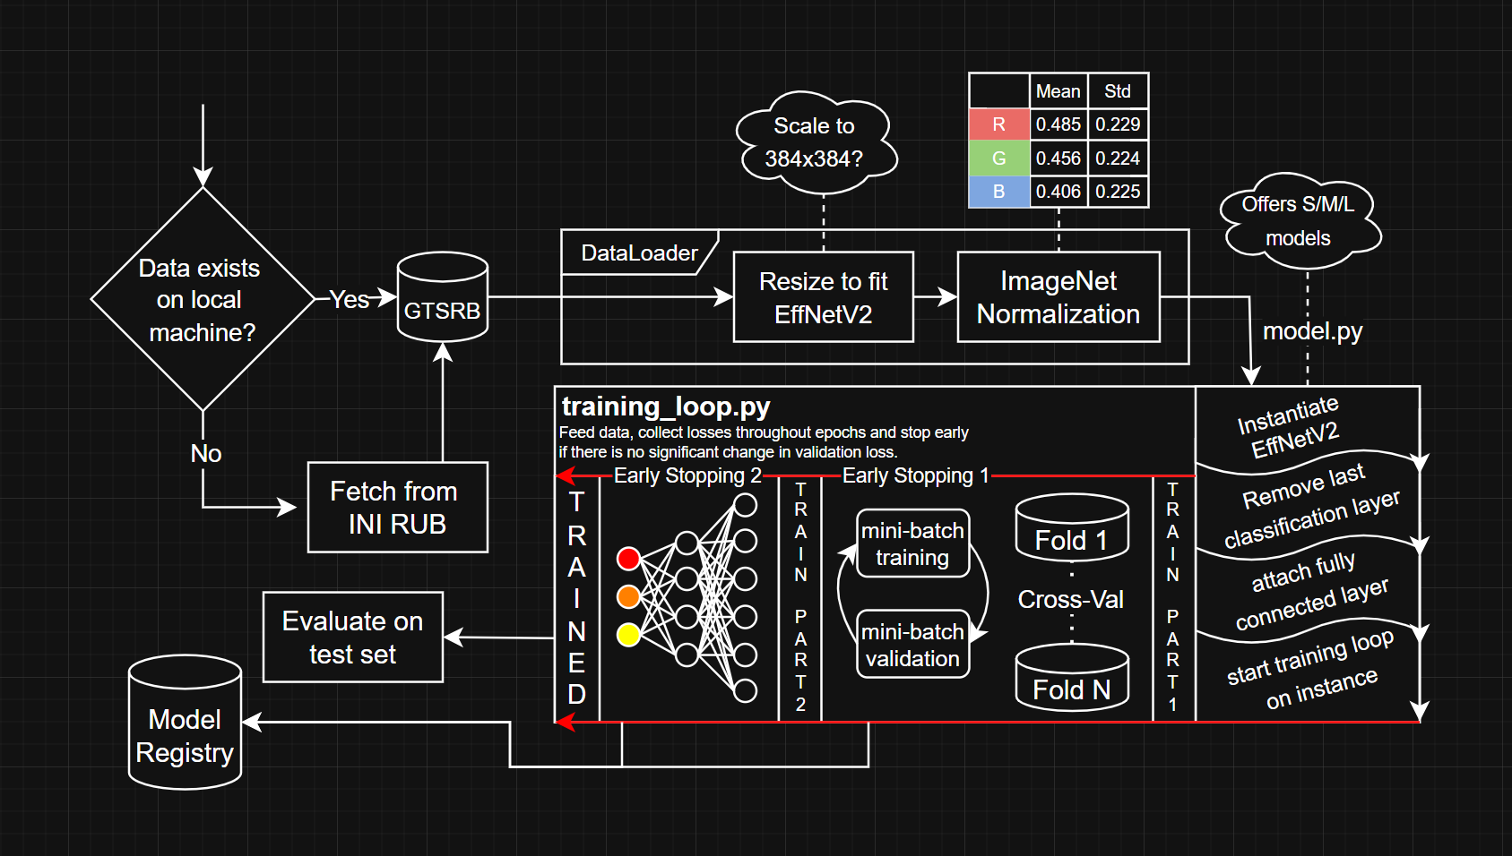
Pipeline Architecture (WIP)
Intermediate Presentation

Slide 7
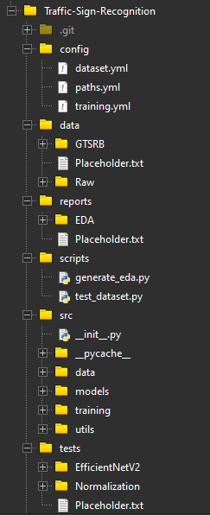
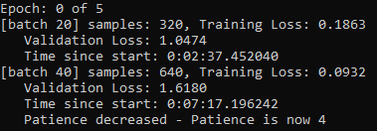
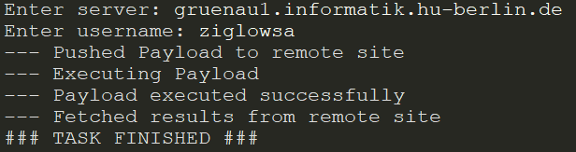
Status Quo
Intermediate Presentation
Mid-epoch early stopping by checking every x batches because of dataset size
A Payloader that puts code on the Uni servers and executes it

Slide 8
Images
Intermediate Presentation
https://www.jalopnik.com/jalopnik/images/xaep1mjulbizalswddfg.jpg
https://images.pexels.com/photos/2994331/pexels-photo-2994331.jpeg?cs=srgb&dl=pexels-athena-2994331.jpg&fm=jpg
https://www.jalopnik.com/jalopnik/images/etvtn2zentybmnb0sxlf.jpg

Slide 9
Questions?
16.12.2025

